Slide 1
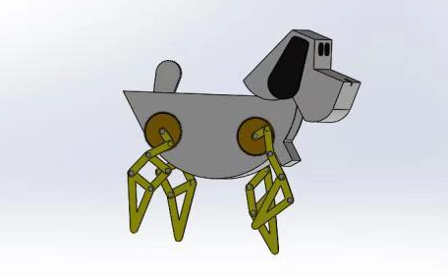
Linkage Design Final Project
“4-Legs Walking Robot”
14:650:455:01 Fall2020 DESIGN OF MECHANISMS
Group Members:
Zhijing Hu, Pik Luen Li, Feihao Ding, Dawei Hu

Slide 2
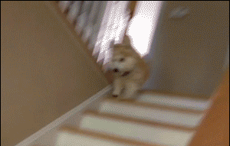
Intro and Background
Prototype: 4 legs mammal
Linkages: Four-Bar
Applications:
Exploration of dangerous site;
Package delivery or pick up;
Climbing steps or vertical jump;
Uneven road conditions...
Why a mechanism is needed:
To reduece or eliminate the limitation of robot with wheels.
Be safe, efficient, remotable, adaptable...
Notes:
The exploration of the unknown world has always been the subject and the goal of human science progress. The most intuitive way to explore is to collect samples and conduct research. There may be some danger in many unknown areas, so operating machines and robots instead of sending people would be a good choice.
The deep sea and outer space environment have been a hot topic in current scientific exploration since last two century. Our design is mainly to achieve the function of grabbing objects and realize the goal of collecting.
Usually, the above jobs are done by robot with wheels which is efficient and easy. However, with ...

Slide 3
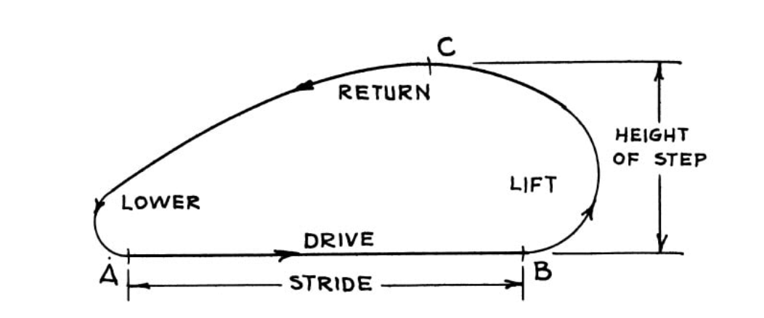
Intro and Background
Design objective: Design a walking robot that resemble a 4-legs mammal such as dogs/bears with a simple four-bar linkages system.
Required motions/path:
To produce a footpath similar to mammals. The shape could be different from this. But the stride part should be as flat as possible to avoid bouncing of the robot.
Spatial constraints:
Height of the step is approximately 40cm
Stride should be approximatly 50cm
(according to the size of our robot)
Notes:
The exploration of the unknown world has always been the subject and the goal of human science progress. The most intuitive way to explore is to collect samples and conduct research. There may be some danger in many unknown areas, so operating machines and robots instead of sending people would be a good choice.
The deep sea and outer space environment have been a hot topic in current scientific exploration since last two century. Our design is mainly to achieve the function of grabbing objects and realize the goal of collecting.

Slide 4
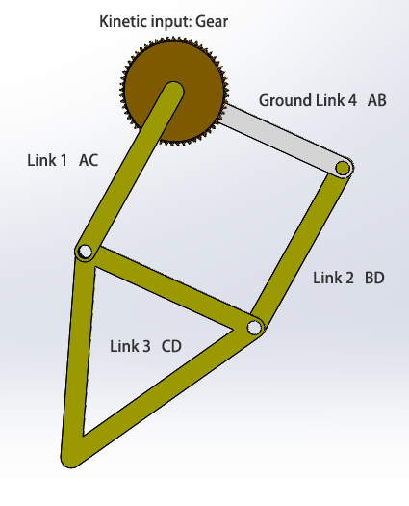
Design Process and Method
Mechanism Synthesis
Design Procedures:
Find prototypes and understand its locomotory
Compare and analyze different linkage designs
Finalize CAD models and simulate linkage motion paths
Calculations 3D -> 2D on one robot foot:
Let’s focus on link 1,2,3,4:
DOF = 3(L-1) - 2J - K
= 3*(4-1)-2*4-0
=9-8=1

Slide 5

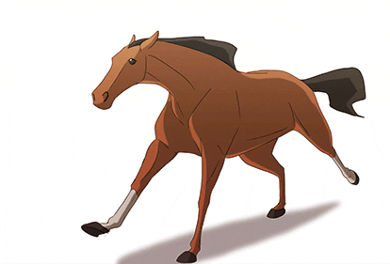
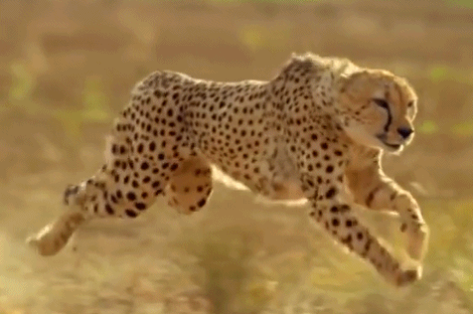
Design Process and Method
Design Goal：
Exploration
Efficiency
Daily activities(expresses, shopping, freight)
Unknwn places
Industry
Relief effort
Design Logic：
Speed patterns
Climb steps, even jump
Bigger and more powerful
Adapatability
Multi-functionalities
（这一面还没翻译还没翻译！）
Notes:
The exploration of the unknown world has always been the subject and the goal of human science progress. The most intuitive way to explore is to collect samples and conduct research. There may be some danger in many unknown areas, so operating machines and robots instead of sending people would be a good choice.
The deep sea and outer space environment have been a hot topic in current scientific exploration since last two century. Our design is mainly to achieve the function of grabbing objects and realize the goal of collecting.

Slide 6
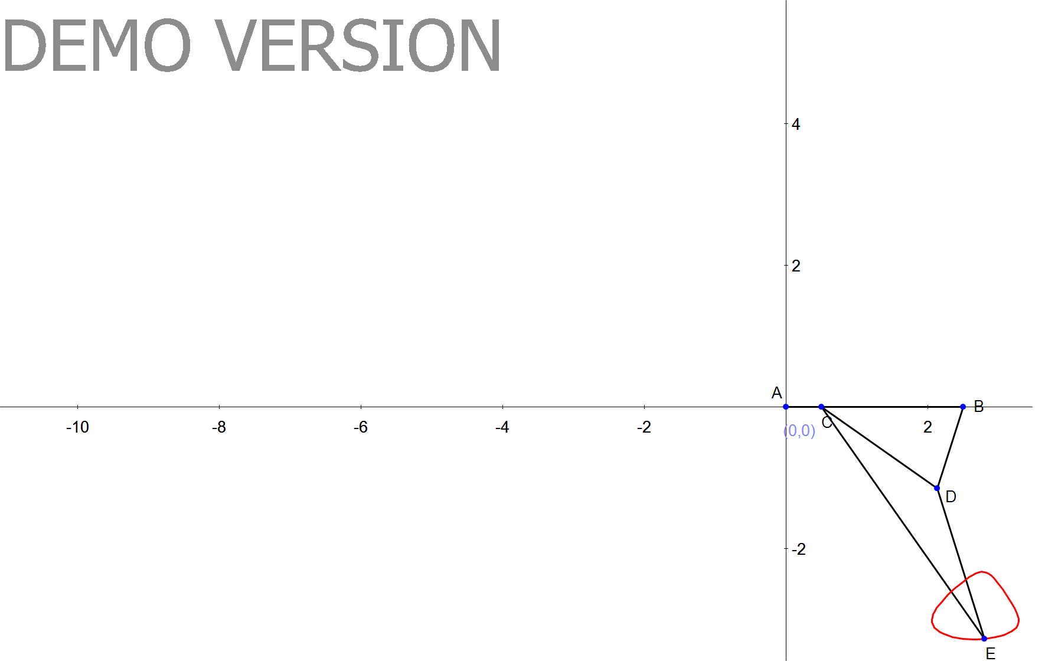
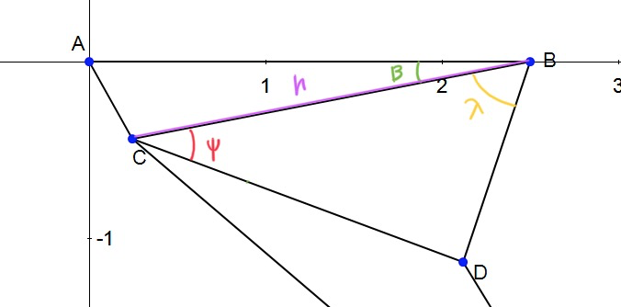
Position Analysis
Assume AB=100, AC= 20, CD=80, BD=48, CE=160, alpha=20 degrees, angular velocity of AC=w2= 1.57 rad/s, and theta 2=20 degrees, position of point E (footpath) could be found with theta2 from 0 to 360 degrees. (Unit: cm)
h=sqrt(AB^2+AC^2-2*AB*AC*cos(theta 2))
beta=acos((AB^2+h^2-AC^2)/(2*AB*h))
psi=acos((CD^2+h^2-L3^2)/(2*CD*h))
lamda=acos((BD^2+h^2-CD^2)/(2*BD*h))
theta3=psi-beta
=psi+beta (for theta>180)
theta4=180-lamda-beta
=180-lamda+beta (for theta>180)
Ax=Ox+AC*cos(theta 2)
Ay=Oy+AC*sin(theta 2)
Ex=Ax+CE*cos(alpha+theta 3)
Ey=Ay+CE*sin(alpha+theta 3)

Slide 7
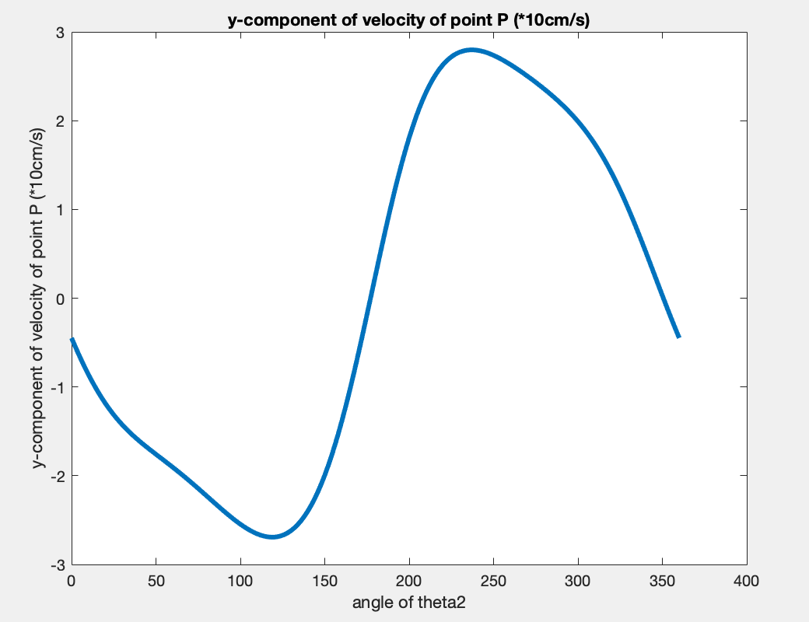
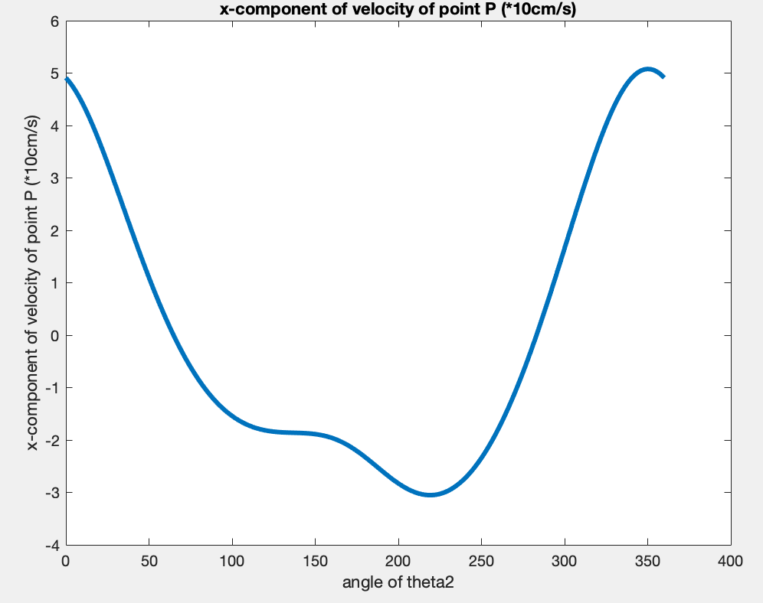
Velocity Analysis
From position analysis, theta 3 is obtained. Velocity of point E could be calculated as following.
Angular velocity of CD=w3
=AC*w2/CD*sin(theta 4-theta 2)/sin(theta 3-theta 4)
theta 5=alpha+theta 3;
velocity of x component of E=V_Ex
= -AC*sin(theta 2)*w2-CE*sin(theta 5)*w2;
velocity of y component of E=V_Ey
= AC*cos(theta 2)*w2+CE*cos(theta 5)*w2;

Slide 8
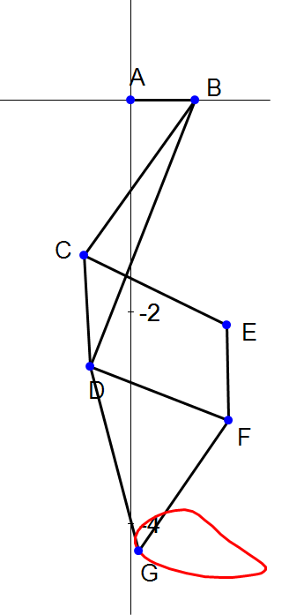
Results and Discussion
Original design
5-bar linkage
Final design
4-bar linkage
 | delta x | delta y
5 bar | 49.6 cm | 25.68 cm
4 bar | 49.2 cm | 38.16 cm
Scale magnifying -> cm to m
Keep x displacement in small difference, more y displacements could be achieved

Slide 9
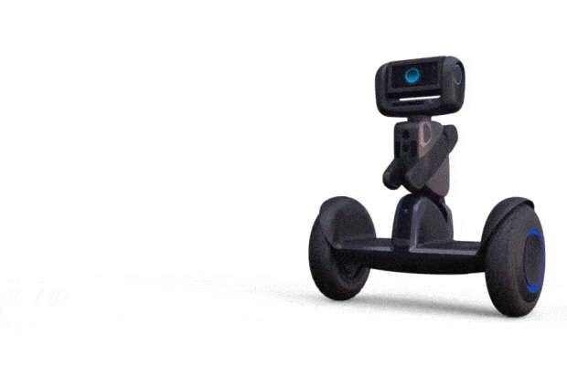
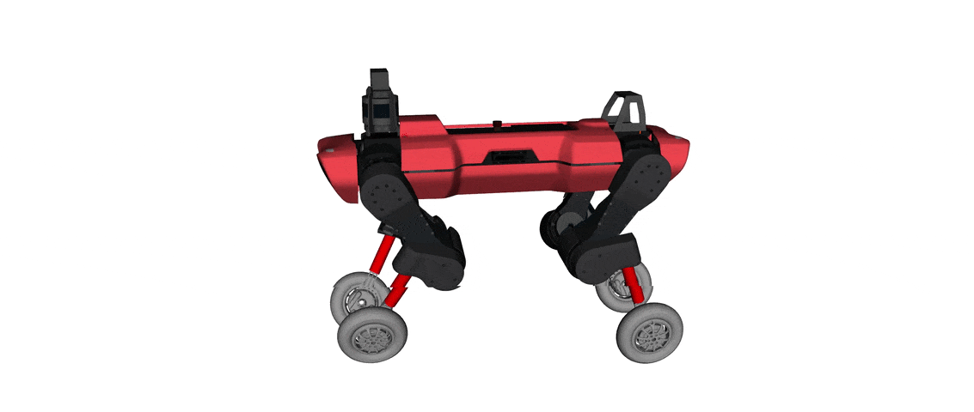
Results and Discussion
Compare with conventional wheel robot,
also from the analyzed results in previous slides: the calculations on one specific robot foot,
3D -> 2D
Advantages of our design:
Suitable for ascending steps
Vertical leap
Independent four robot feet
(change directions, speeds...)
Carry heavy stuffs
(boxes, shopping bags...)
Various footset for different enviorment condition
(rescue operation, swimming crossing waterpath...)
Notes:
The exploration of the unknown world has always been the subject and the goal of human science progress. The most intuitive way to explore is to collect samples and conduct research. There may be some danger in many unknown areas, so operating machines and robots instead of sending people would be a good choice.
The deep sea and outer space environment have been a hot topic in current scientific exploration since last two century. Our design is mainly to achieve the function of grabbing objects and realize the goal of collecting.

Slide 10
Conclusion
Lesson learned:
The position and velocity analysis of a four-bar linkage system;
Graphical synthesis for design system
Building linkage animation with Mechanical Expression;
Analysing linkage system using Matlab, SolidWorks;
Basic moving robot with four-bar linkage system...
Future work:
Explore how the efficiency and stability of the robot are related to the length of different links;
Find the perfect linkage systems for animal-shaped robots;
Find the low cost materials for linkages design...
(Coding learning if need to maunfacture a real one!!)

Slide 11
Tasks Distrubutions
All slides work, models and analysis calculations are closely collaborated by each team members then finished the whole project. No priorities in work values.
First presenter (Feihao Ding)
Sort material and data
Matlab coding and drawings
Second presenter (Zhijing Hu)
Select design theme and procedures
CAD model designing and drawing
Third presenter (Pik Luen Li)
Motion path analysis
Velocity calculations
Fourth presenter (Dawei Hu)
Create linkage animations
Results date collections

Slide 12
Thank you for listening!
Any Questions?

